Slide 1
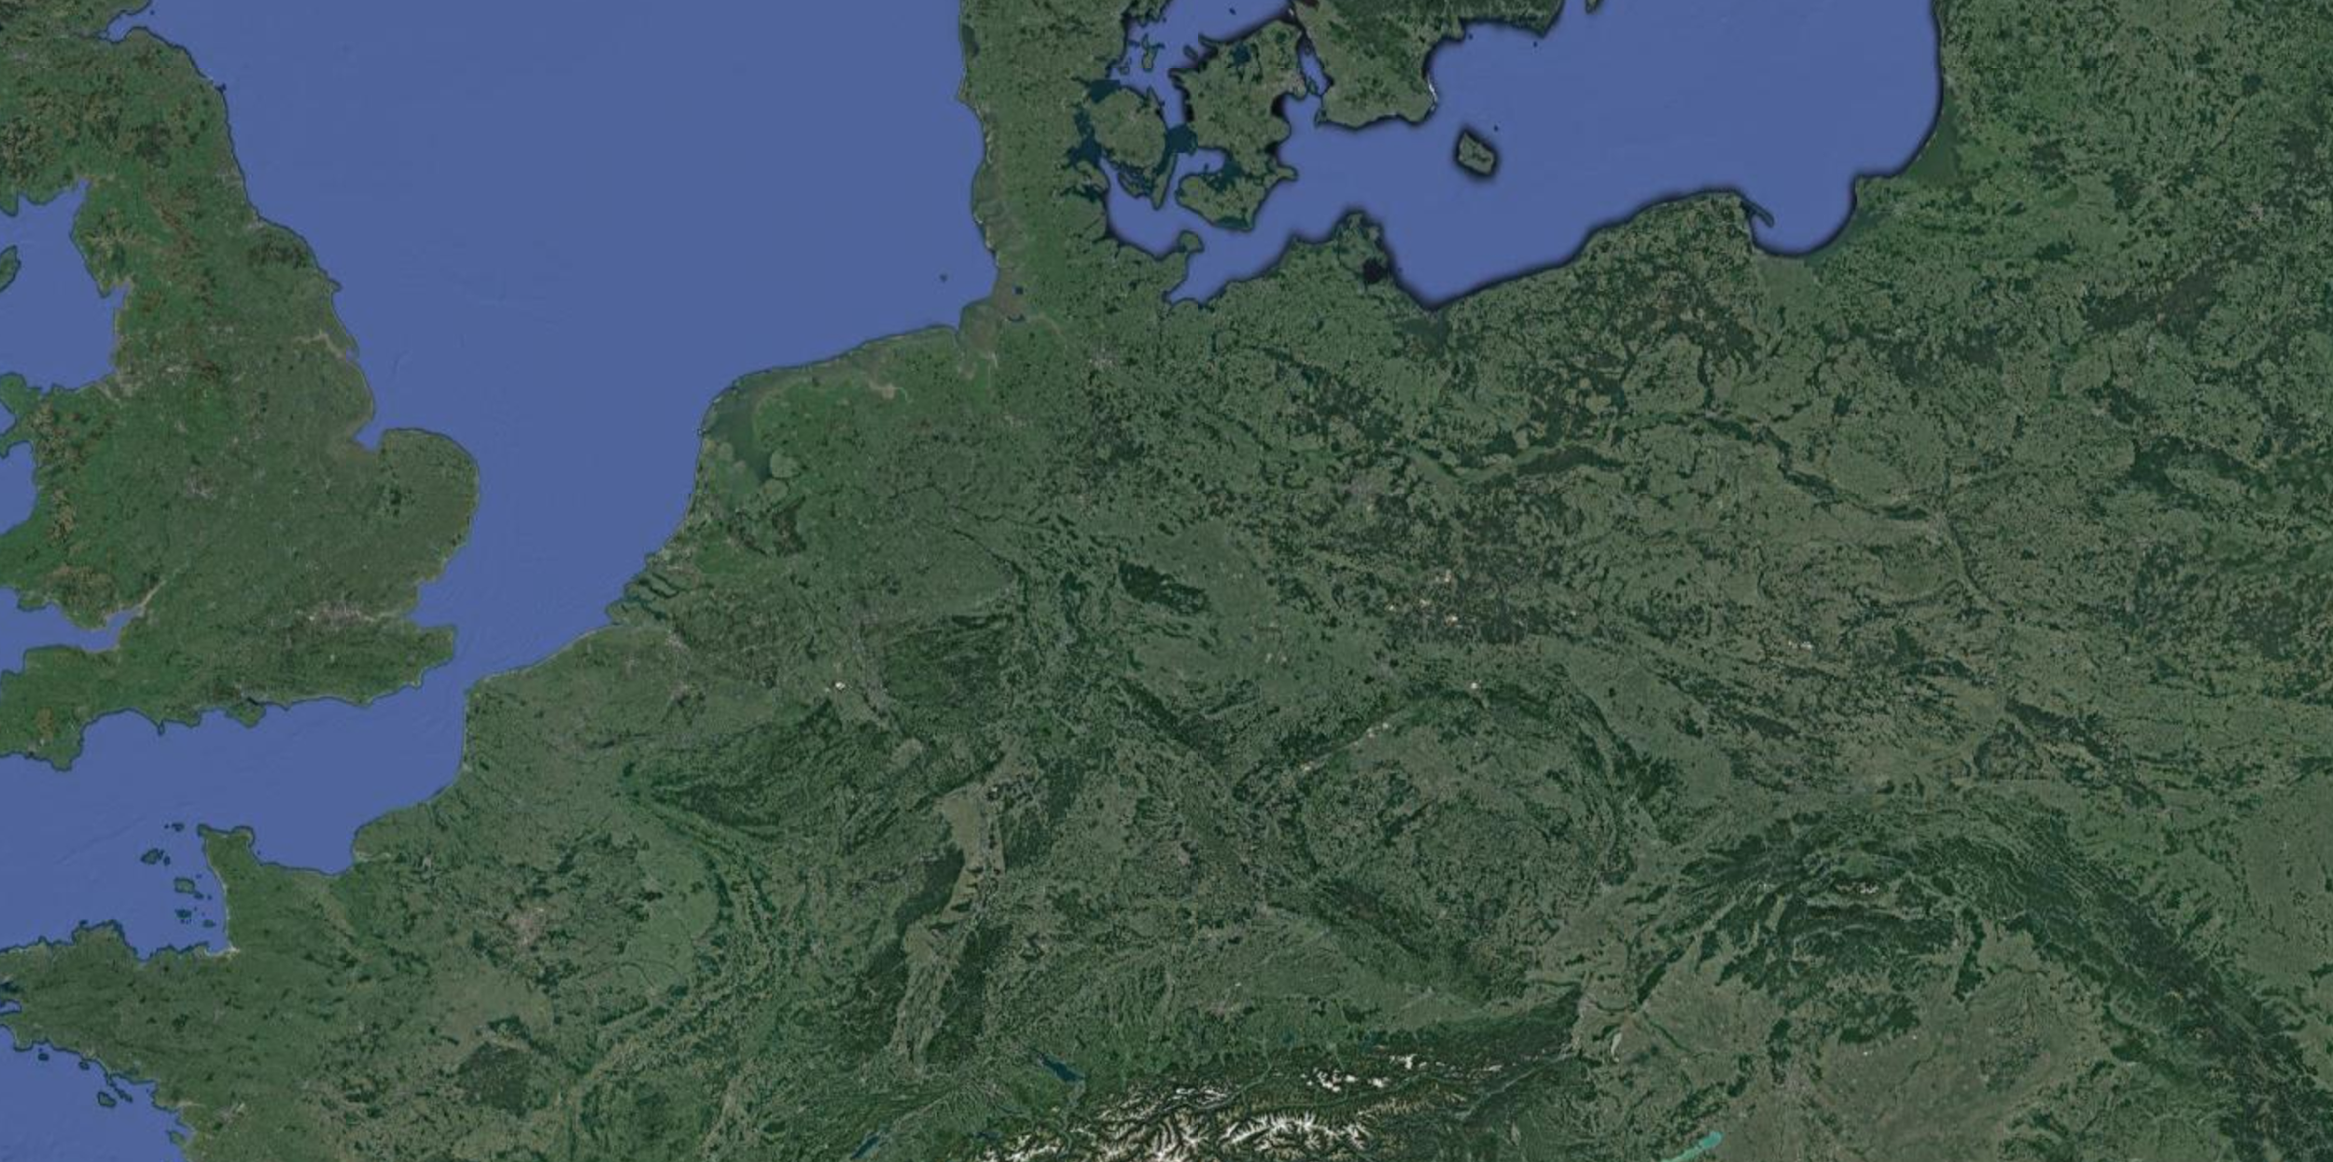
Notes:
Lets dive in to germany

Slide 2
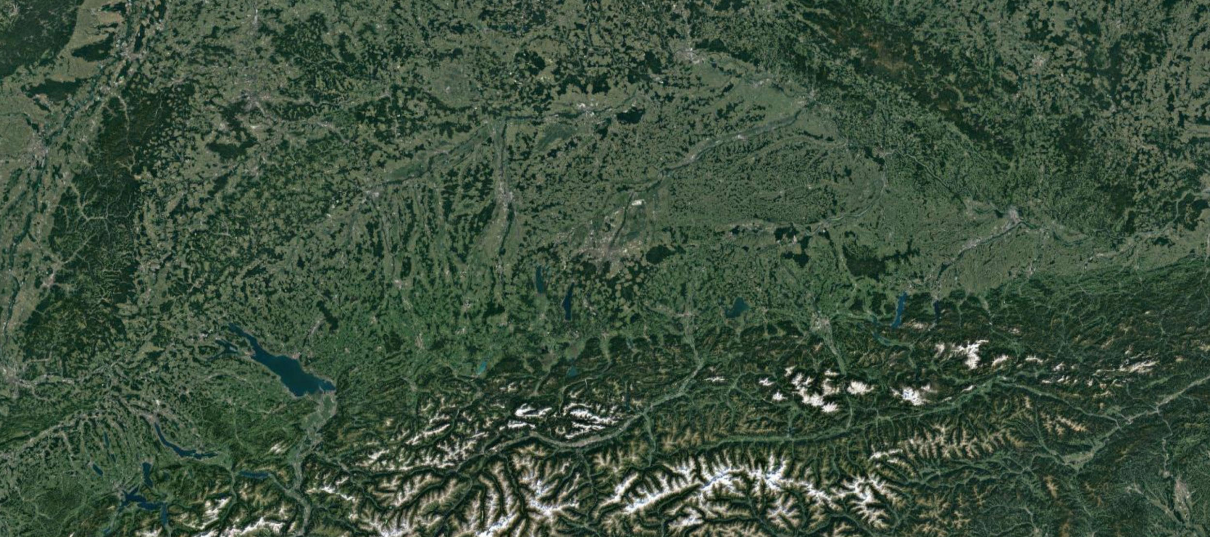

Slide 3
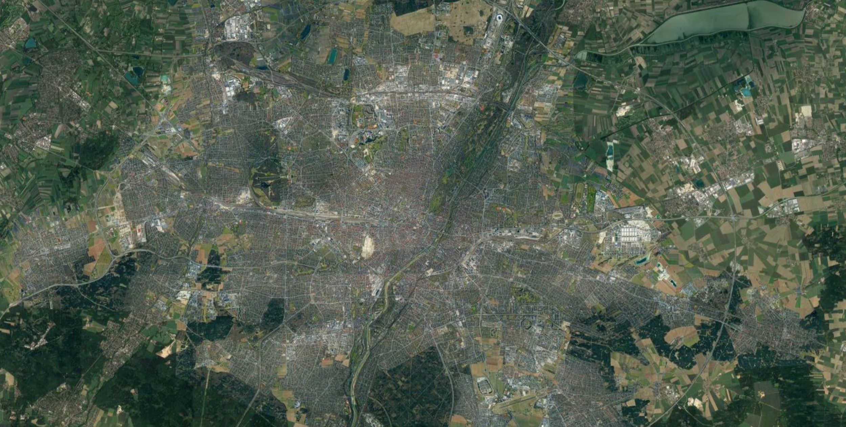

Slide 4
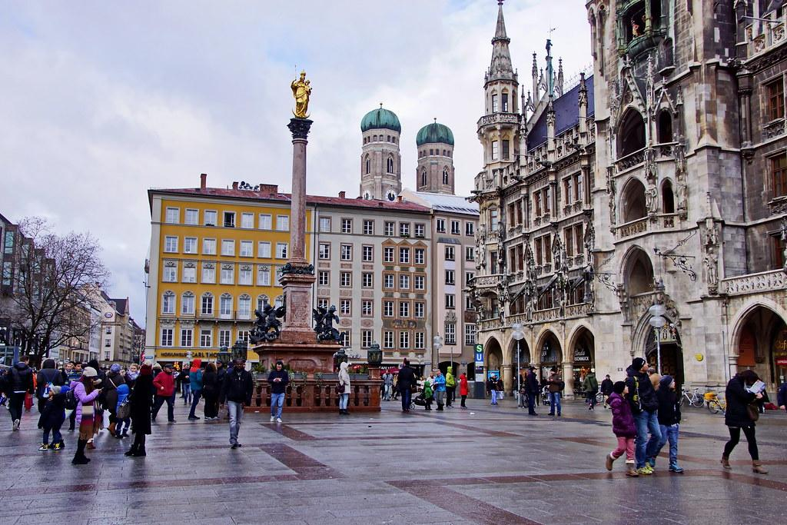

Notes:
Driving to Marienplatz with the S-Bahn

Slide 5

Notes:
WE HAVE THE Right tool for you

Slide 6



Slide 7
TEAM:
Lukas Holzner
Alexandre Mercier
Alexandra Lang
Maik Luu Bach
Notes:
Unfornately our fourth is sick today

Slide 8

Motivation
Confusion for visitors or new residents in a city with a lot of opportunities and offers
Optimizing the path to get culture (or beer)
Limited traveltime

Slide 9
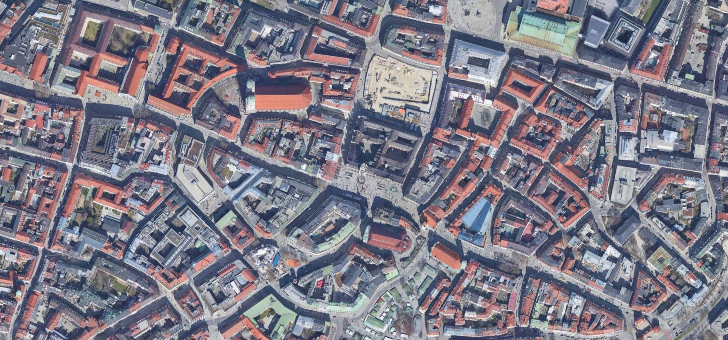
Notes:
Difficult to get around in a unknown city

Slide 10


Until now:
Trip planning is time consuming and expensive
Notes:
Problem erklären: große Stadt, overwhelmed by offers and choice in new unknown city. Bisher: Feunde/Kontakte/Intensive Recherche, Jetzt: Suche wird vereinfacht durch ‘curated/reviewed/established’ Angebote

Slide 11
Project Description
The user put their available time in and choose which category they want to discover in Munich
Our algorithm provides the user with a path to visit selected places in their time frame
Notes:
Nicht nur Touris, auch für einheimische die neues entdecken wollen :)
Weniger Text? -> Stichpunkte + auf 2 Slides aufteilen
Problem erklären: große Stadt, overwhelmed by offers and choice in new unknown city. Bisher: Feunde/Kontakte/Intensive Recherche, Jetzt: Suche wird vereinfacht durch ‘curated/reviewed/established’ Angebote

Slide 12
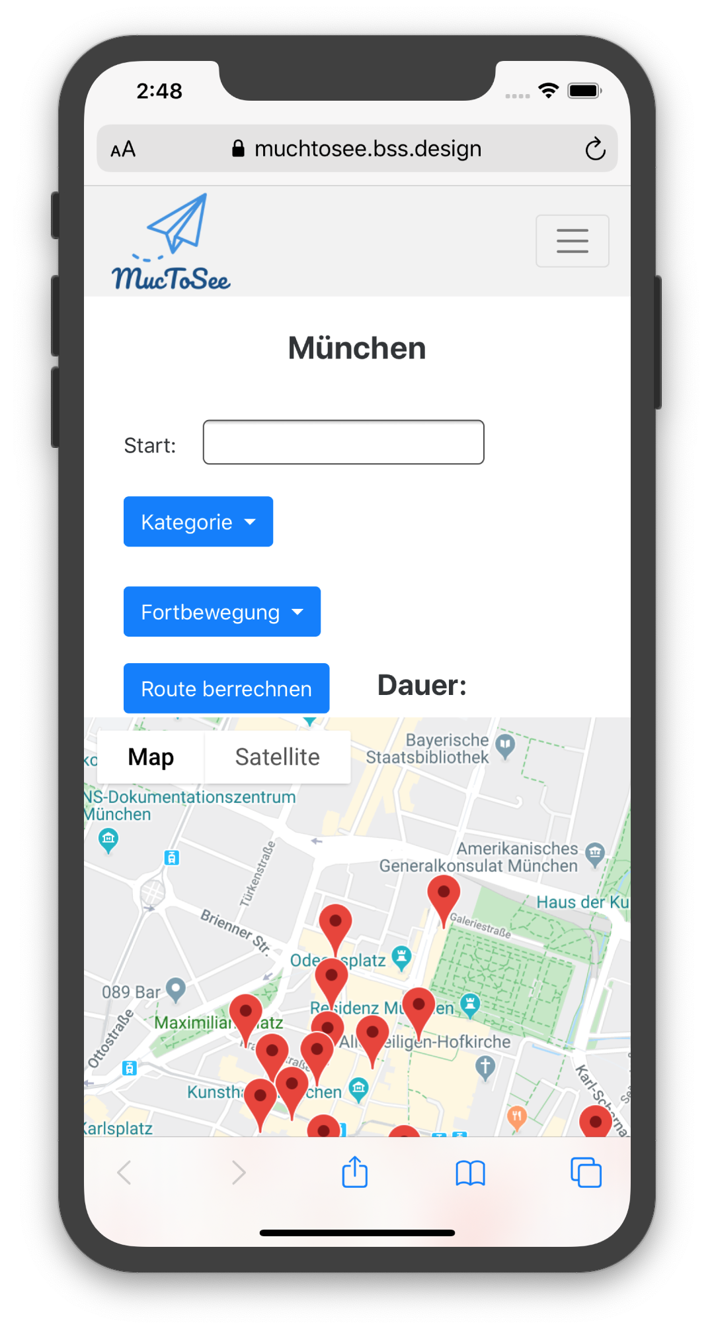
First Look
Layout

Slide 13
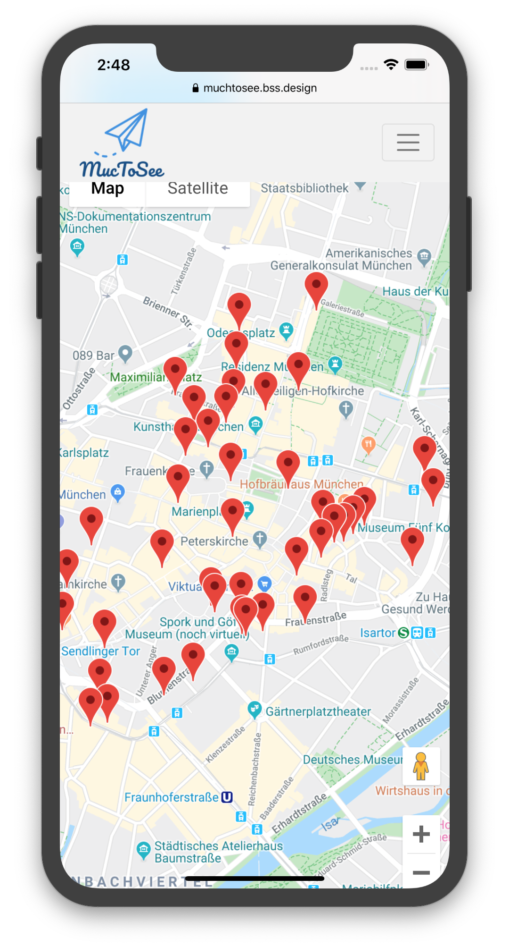
First Look
Layout

Slide 14
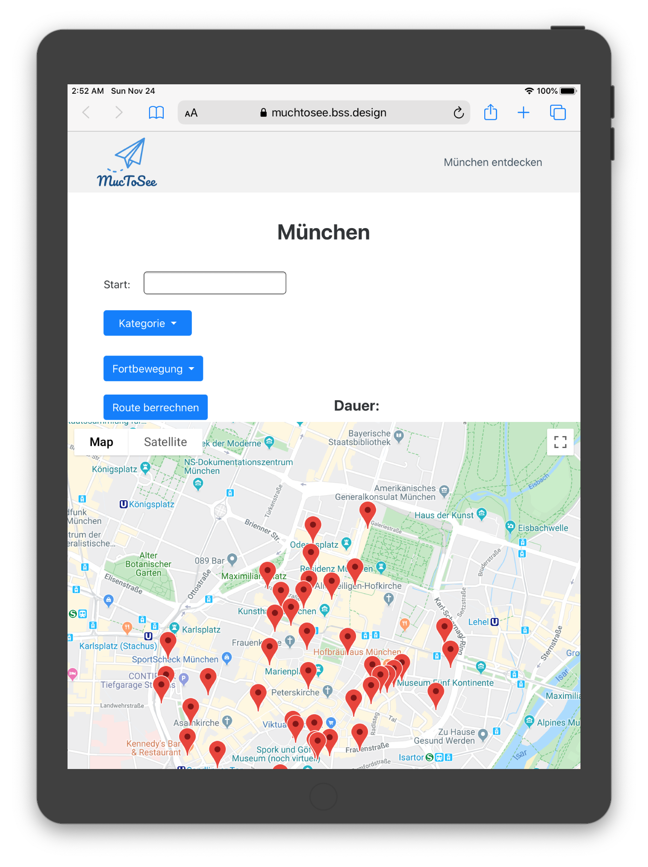
First Look
Layout (Fully responsive)

Slide 15
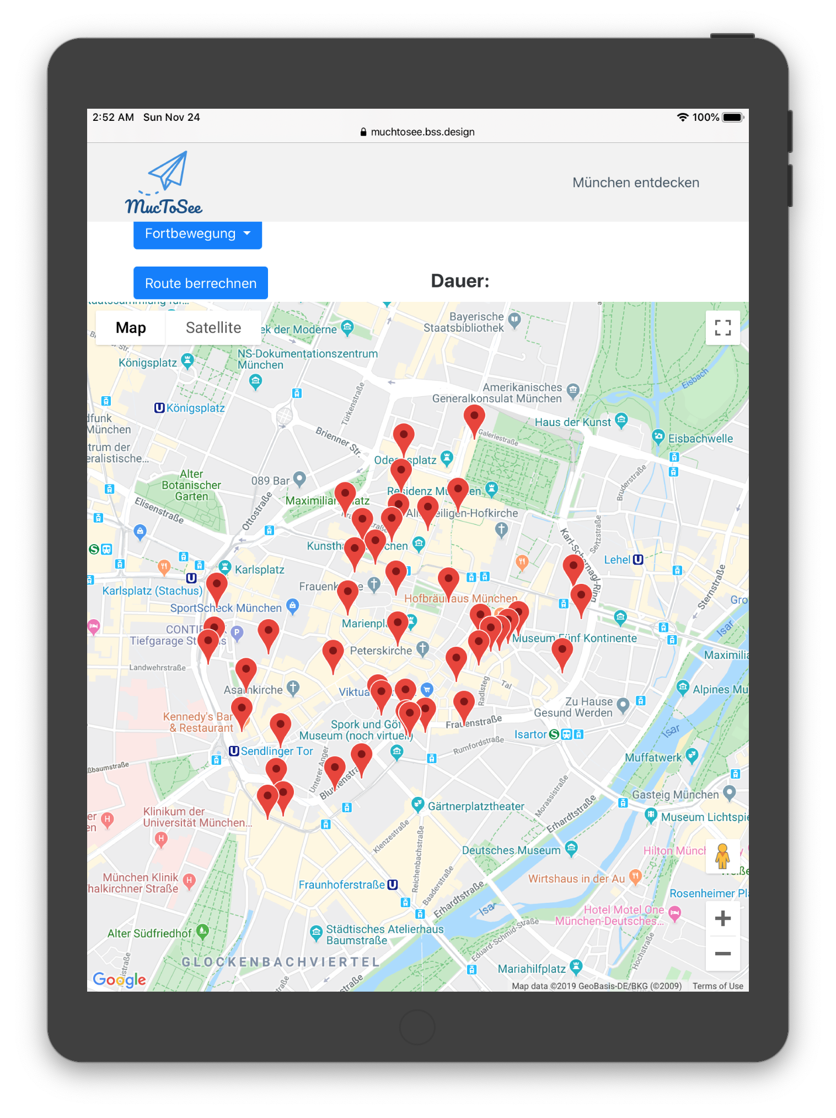
First Look
Layout (Fully responsive)

Slide 16
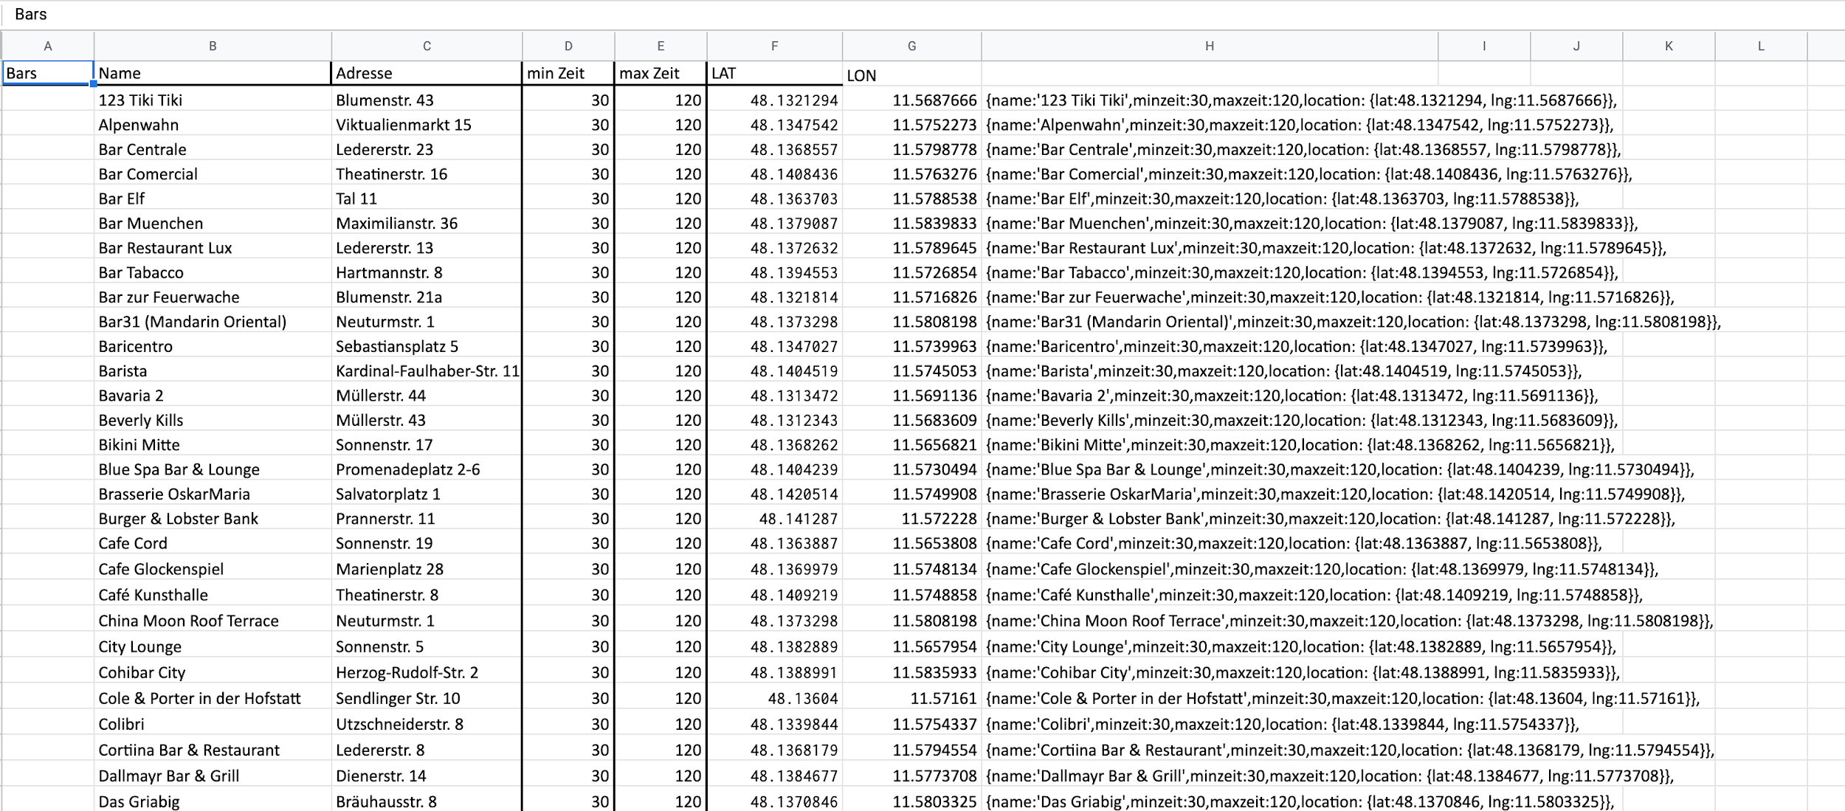
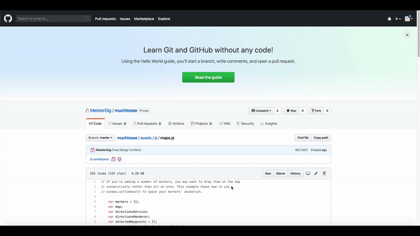
First Look
Converted POI to this:
Backend
And used
Vanilla JS
Notes:
Imported POI Database from munich and added our own Data
Used Javascript
but I bet you want to see it in action

Slide 17

Live Demo

Slide 18
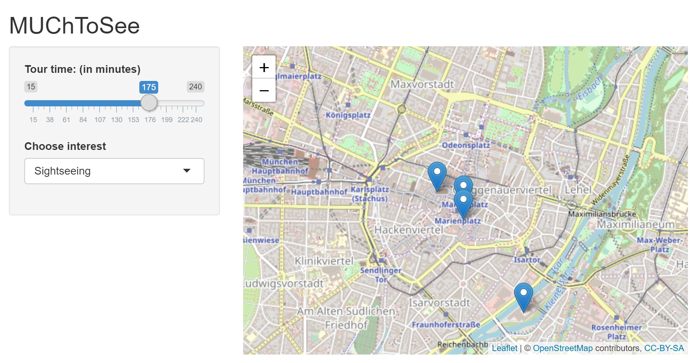
Going forward...
Manual ‘station selection’ will change to ‘automatic route creation’
Consider opening times of places
Improve options for locals
…
Expand to other cities
Notes:
Transit from manual station selection to automatic route creation
NP Problem of “find the best combination”
A basic version is actually working in R, has to be translated to JavaScript

Slide 19
Try it yourself!
bit.ly/MUChtoSee

Slide 20
Thank you for your attention!

